Slide 1
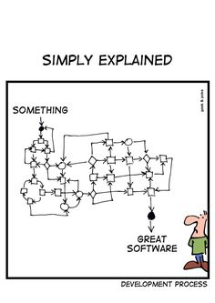
Software Development Process www.cs.uoi.gr/~zarras/http://www.cs.uoi.gr/~zarras/se.htm
Slides material sources:
Software Engineering - Theory & Practice, S. L. Pfleeger
Introduction to Software Engineering, I. Sommerville
SWEBOK v3: IEEE Software Engineering Body of Knowledge

Slide 2
Software engineering fundamentals

Slide 3
What is software?

Slide 4
What is software?
Computer programs and associated documentation.
Software products may be developed for a particular customer or may be developed for a general market.

Slide 5
What is software engineering?

Slide 6
What is software engineering?
ISO/IEC/IEEE Systems and Software Engineering Vocabulary (SEVOCAB) defines software engineering as
“the application of a systematic, disciplined,
quantifiable approach to the development,
operation, and maintenance of software;
that is, the application of engineering to software”

Slide 7
Development process fundamentals

Slide 8
What is a software development process?

Slide 9
What is a software development process model ?
A structured set of activities required to develop a software system.
There are many different software processes but all involve these key activities:
  Requirements specification – defining what the system should do.
  Design and implementation – defining the organization of the system and implementing the system.
  Verification & Validation – checking if it works correctly and if it does what the customer wants.
  Evolution – changing the system in response to changing customer needs.

Slide 10
Well known software development processes … a historical retrospection

Slide 11
How do we develop small programs for internal operation/personal use?

Slide 12
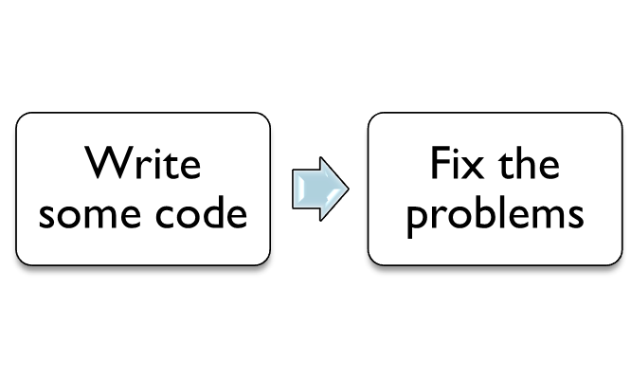
The code & fix model
In the introduction of the Spiral model Boehm refers to the basic model used in the earliest days of software.

Slide 13
What is wrong with that?

Slide 14
The code & fix model
After a number of fixes, subsequent fixes may become very expensive.
Frequently, the software becomes a poor match to users’ needs that it is rejected or redeveloped.

Slide 15
The code & fix model
Code is expensive to fix because of poor preparation for testing and modification.
Lack of requirements analysis and design.

Slide 16
How do we develop larger programs for delivery to a customer?

Slide 17
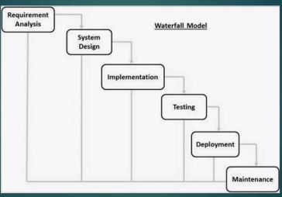
Traditional Waterfall Model

Slide 18
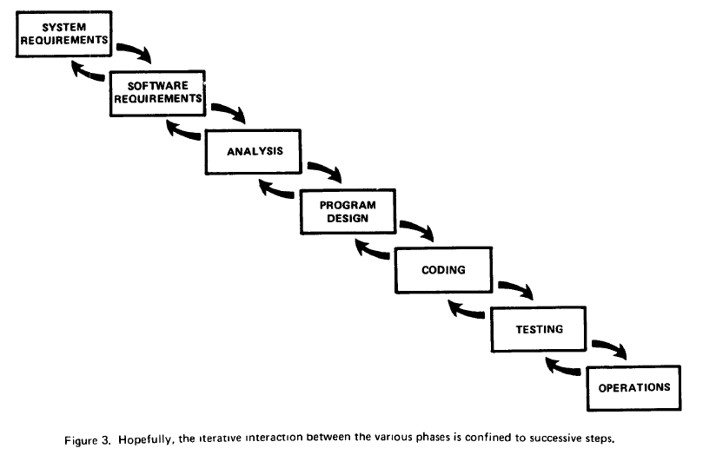
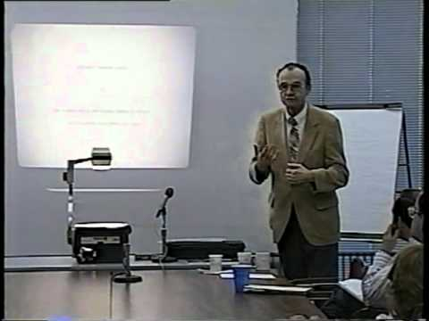
The waterfall model
W. W. Royce, Managing the Development of Large Software Systems: Concepts and Techniques, Proc. of Wescon, 1970.
Also available in Proc. 9th Int’l Conf. Software Engineering (ICSE), 1987
A highly influential refinement of the stage-wise model. It provided two primary enhancements to the stage-wise model

Slide 19
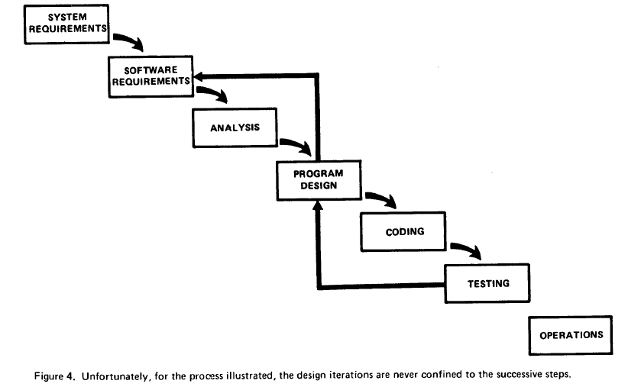
The waterfall model
W. W. Royce, Managing the Development of Large Software Systems: Concepts and Techniques, Proc. of Wescon, 1970.
Also available in Proc. 9th Int’l Conf. Software Engineering (ICSE), 1987
(1) Recognition of the feedback loops between stages, and a guideline to confine the feedback loops to successive stages to minimize the expensive rework involved in feedback across many stages.

Slide 20
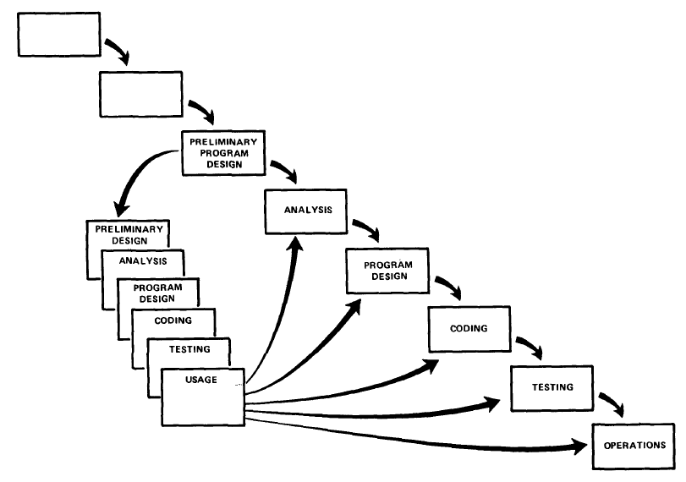
The waterfall model
W. W. Royce, Managing the Development of Large Software Systems: Concepts and Techniques, Proc. of Wescon, 1970.
Also available in Proc. 9th Int’l Conf. Software Engineering (ICSE), 1987
(2) An initial incorporation of prototyping in the software life cycle, via a “build it twice” step running in parallel with requirements analysis
and design.

Slide 21
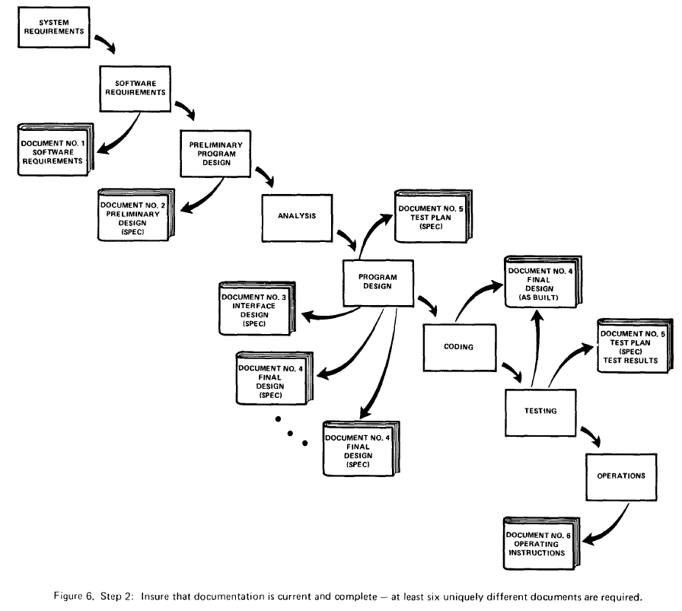
The waterfall model
W. W. Royce, Managing the Development of Large Software Systems: Concepts and Techniques, Proc. of Wescon, 1970.
Also available in Proc. 9th Int’l Conf. Software Engineering (ICSE), 1987
Document the design – At least 6 documents maintained during the whole process.

Slide 22
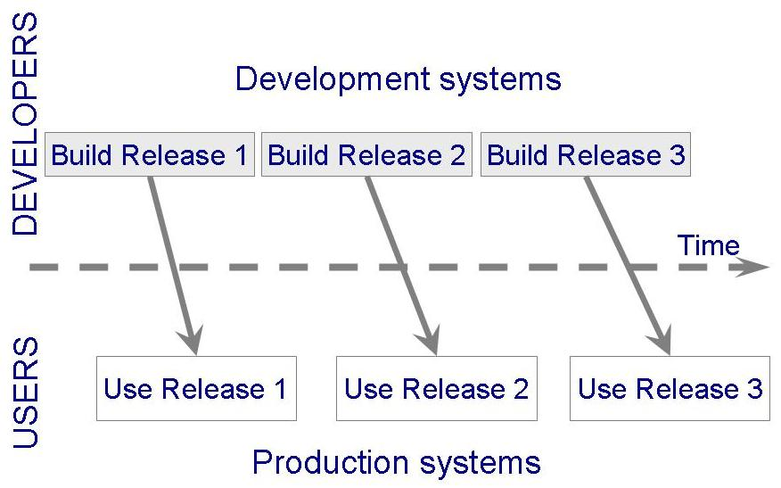
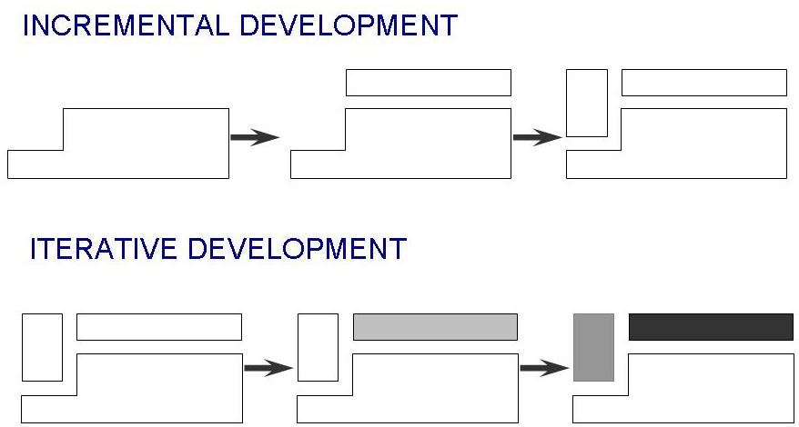
The evolutionary development model
McCracken and Jackson, Life-Cycle Concept Considered Harmful, ACM Software Engineering Notes, pp. 29-32, 1982.

Slide 23
Ok, but how about risks and alternatives?

Slide 24
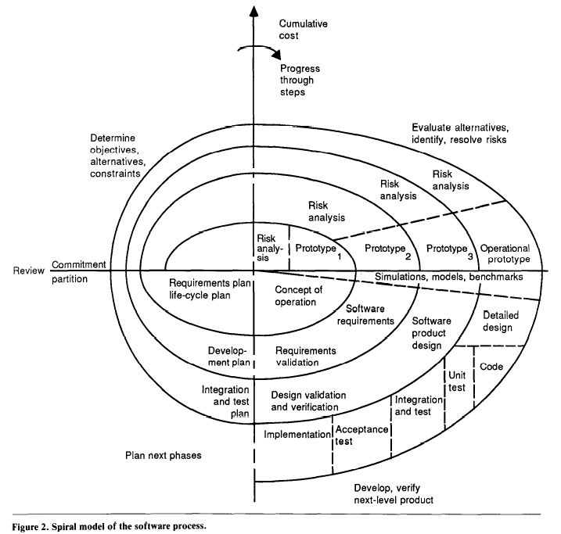
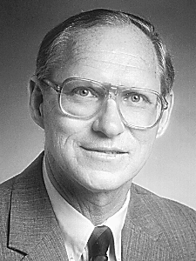
The spiral model
Barry W. Boehm, A Spiral Model of Software Development and Enhancement, IEEE Computer 21(5), pp. 61-72, 1988.

Slide 25
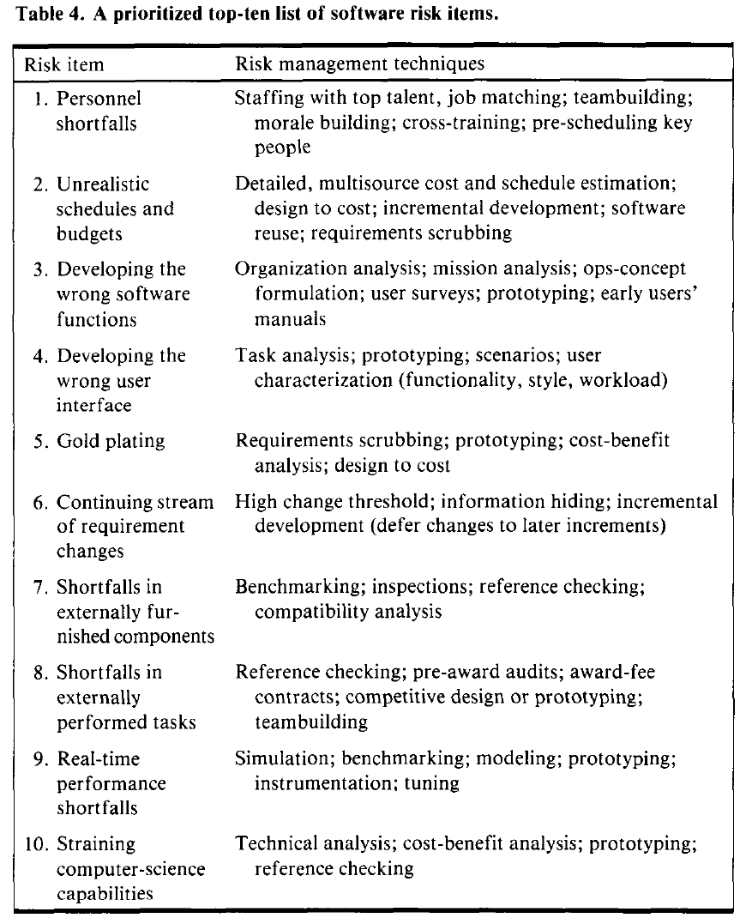
The spiral model
Barry W. Boehm, A Spiral Model of Software Development and Enhancement, IEEE Computer 21(5), pp. 61-72, 1988.

Slide 26
Agile approaches …

Slide 27
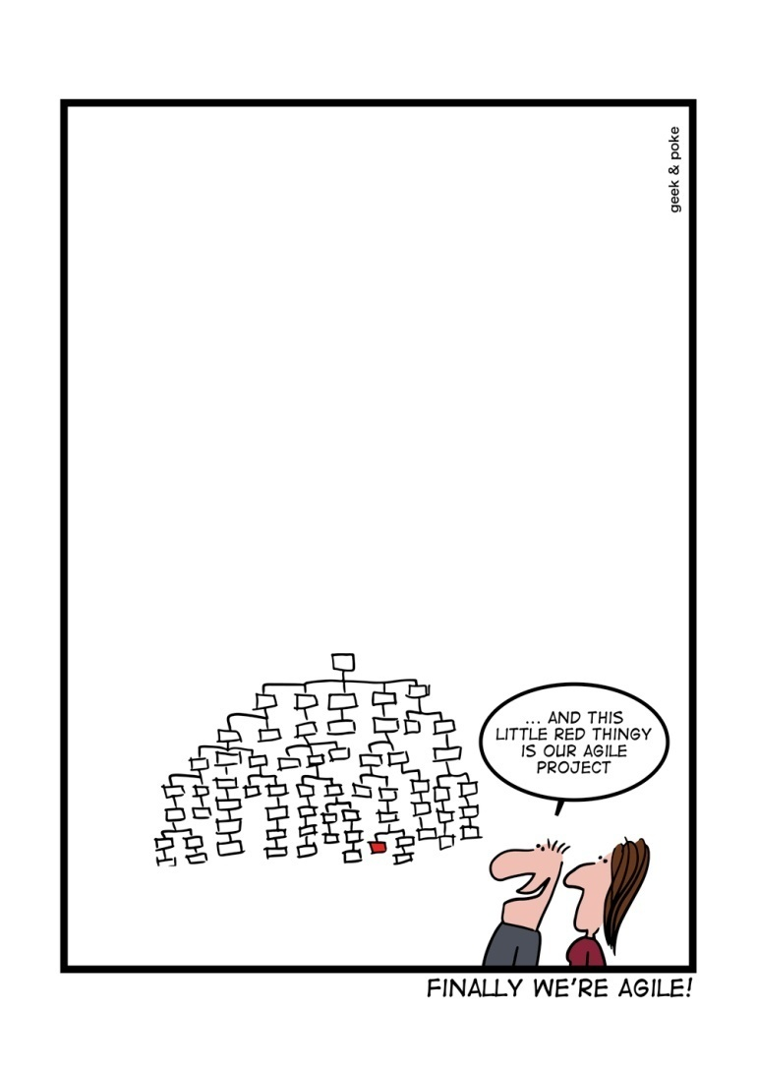
Agile methods
Dissatisfaction with the overheads involved in conventional processes of the 1980s and 1990s led to the creation of agile methods.
The aim of agile methods is to reduce overheads in the software process (e.g. by limiting documentation) and to be able to respond quickly to changing requirements without excessive rework.
Notes:
Περισσότερη ουσία από τύπους

Slide 28
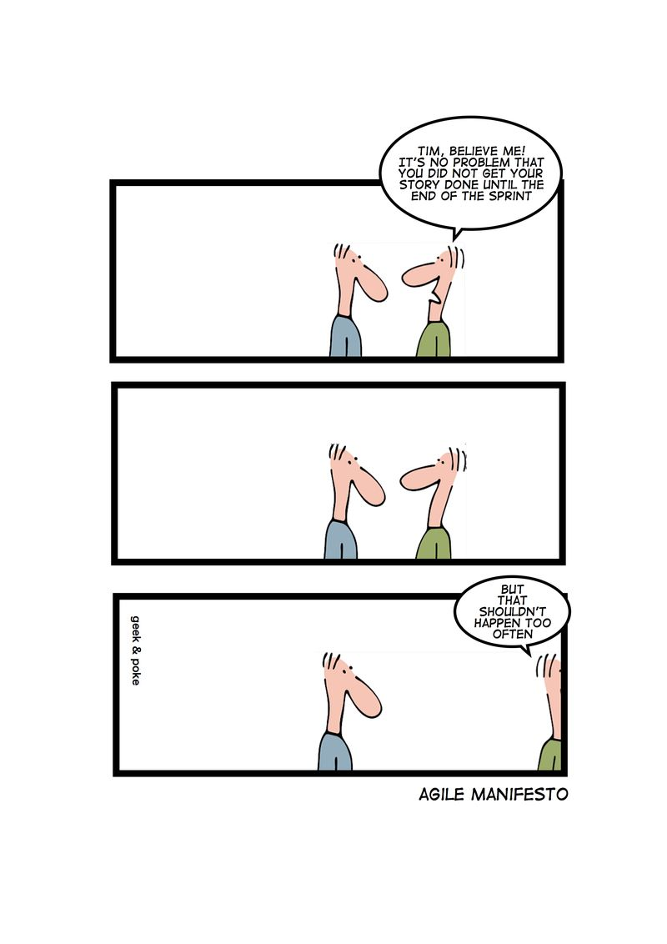
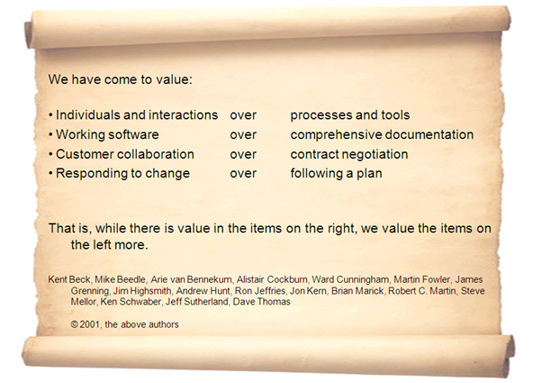
Agile manifesto
Notes:
Διακήρυξη
4 σημεία
Με βάση αυτά πρέπει να δοθεί περισσότερη σημασία

Slide 29
eXtreme Programming (XP)

Slide 30
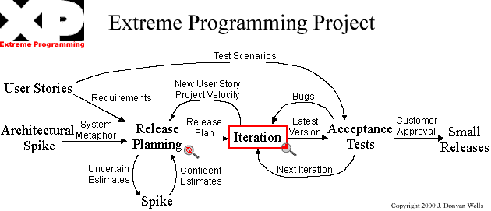
XP model
http://www.extremeprogramming.org/
https://stepmediasoftware.com/blog/extreme-programming/

Slide 31
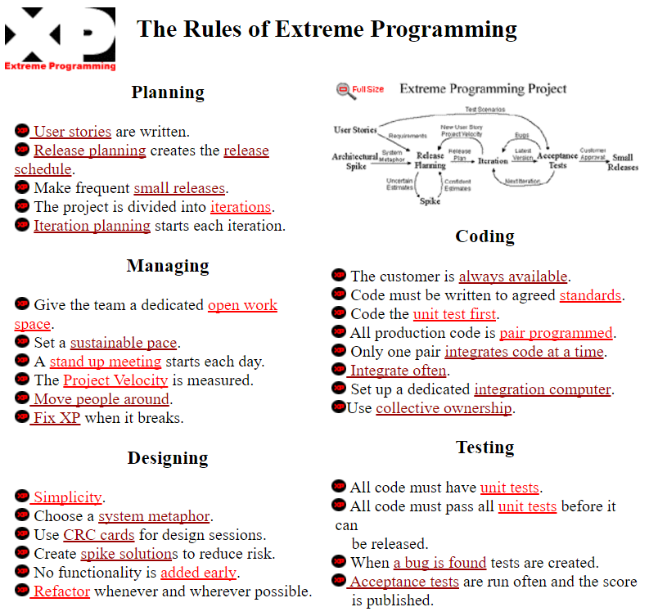

Slide 32
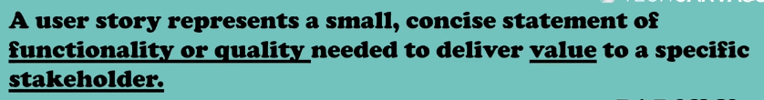
User story

Slide 33
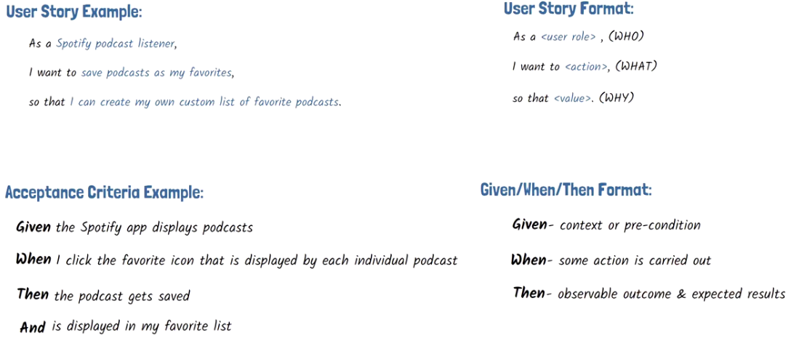

Slide 34
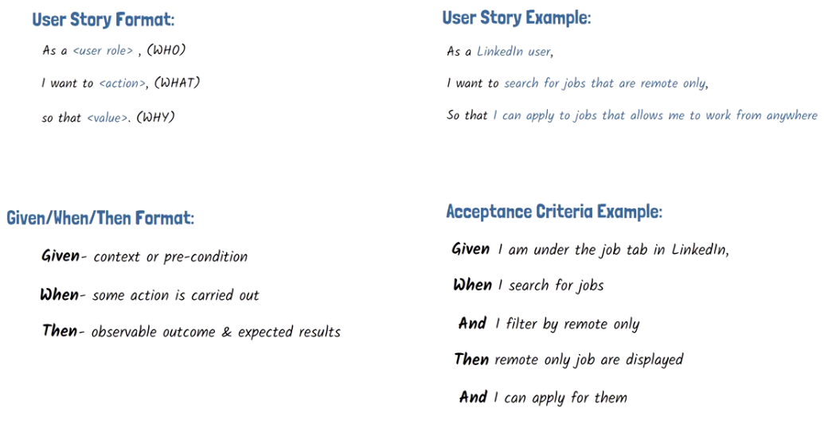

Slide 35
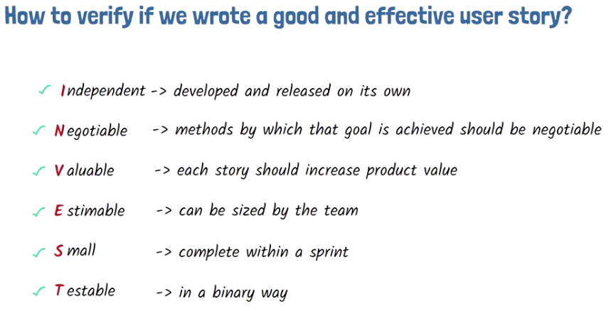

Slide 36
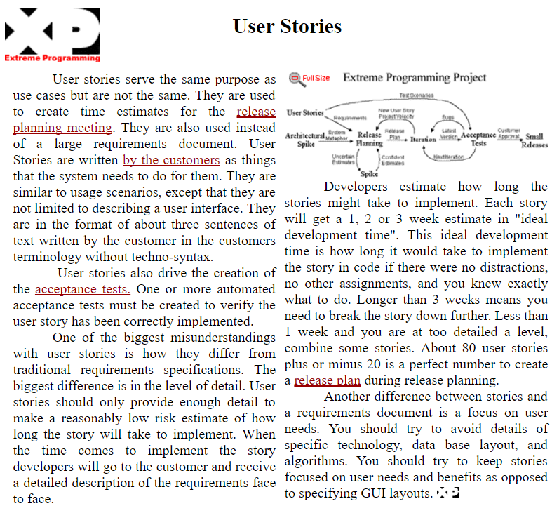

Slide 37
Scrum

Slide 38
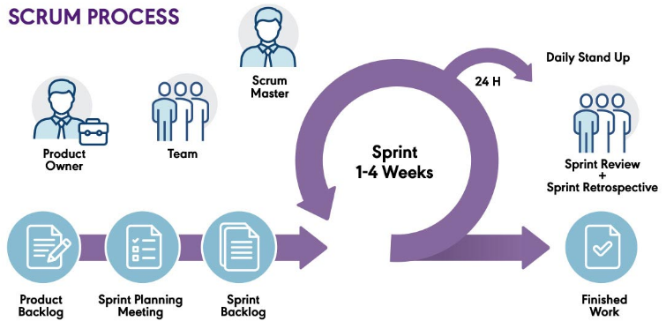

Slide 39
Scrum
https://www.scrumguides.org/
https://cbe.wwu.edu/implementing-scrum-and-agile-management-process-1
Scrum is a process framework that has been used to manage work on complex products since the early 1990s.
Scrum is not a process, technique, or definitive method. Rather, it is a framework within which you can employ various processes and techniques.
Ken Schwaber and Jeff Sutherland

Slide 40
Scrum Team
https://www.scrumguides.org/
The Product Owner is the person responsible for managing the Product Backlog. Product Backlog management includes:
Clearly expressing Product Backlog items;
Ordering the items in the Product Backlog to best achieve goals and missions;
Ensuring that the Product Backlog is visible, transparent, and clear to all, and shows what the Scrum Team will work on next;
Ensuring the Development Team understands items in the Product Backlog to the level needed.

Slide 41
Scrum Team
https://www.scrumguides.org/
The Development Team consists of professionals who do the work of delivering a potentially releasable Increment of “Done” product at the end of each Sprint.
A “Done” increment is required at the Sprint Review. Only members of the Development Team create the Increment.
<= 3 Size of team < 9

Slide 42
Scrum Team
https://www.scrumguides.org/
The Scrum Master is responsible for promoting and supporting Scrum as defined in the Scrum Guide.
Scrum Masters do this by helping everyone understand Scrum theory, practices, rules, and values.

Slide 43
Scrum Events
https://www.scrumguides.org/
The Sprint
The heart of Scrum is a Sprint, a time-box of one month or less during which a “Done”, useable, and potentially releasable product Increment is created. Sprints have consistent durations throughout a development effort.
A new Sprint starts immediately after the conclusion of the previous Sprint.
Sprints contain and consist of the Sprint Planning, Daily Scrums, the development work, the Sprint Review, and the Sprint Retrospective.
During the Sprint: No changes are made that would endanger the Sprint Goal; Quality goals do not decrease; and, Scope may be clarified and re-negotiated between the Product Owner and Development Team as more is learned.

Slide 44
Scrum Events
https://www.scrumguides.org/
Sprint Planning
Sprint Planning is time-boxed to a maximum of eight hours for a one-month Sprint. For shorter Sprints, the event is usually shorter.
Sprint Planning answers the following:
What can be delivered in the Increment resulting from the upcoming Sprint?
How will the work needed to deliver the Increment be achieved?
What => select from Program Backlog
How => designing the product

Slide 45
Scrum Events
https://www.scrumguides.org/
Daily Scrum
The Daily Scrum is a 15-minute time-boxed event for the Development Team. The Daily Scrum is held every day of the Sprint.
Here is an example of what might be used:
What did I do yesterday that helped the Development Team meet the Sprint Goal?
What will I do today to help the Development Team meet the Sprint Goal?
Do I see any impediment that prevents me or the Development Team from meeting the Sprint Goal?

Slide 46
Scrum Events
https://www.scrumguides.org/
Sprint Review
A Sprint Review is held at the end of the Sprint to inspect the Increment and adapt the Product Backlog if needed.
During the Sprint Review, the Scrum Team and stakeholders collaborate about what was done in the Sprint. Based on that and any changes to the Product Backlog during the Sprint, attendees collaborate on the next things that could be done to optimize value.
This is an informal meeting, not a status meeting, and the presentation of the Increment is intended to elicit feedback and foster collaboration. This is at most a four-hour meeting for one-month Sprints. For shorter Sprints, the event is usually shorter

Slide 47
Scrum Events
https://www.scrumguides.org/
Sprint Retrospective
The Sprint Retrospective is an opportunity for the Scrum Team to inspect itself and create a plan for improvements to be enacted during the next Sprint.
Inspect how the last Sprint went with regards to people, relationships, process, and tools;
Identify and order the major items that went well and potential improvements;
Create a plan for implementing improvements to the way the Scrum Team does its work.

Slide 48
Scrum Artefacts
https://www.scrumguides.org/
Product Backlog
The Product Backlog is an ordered list of everything that is known to be needed in the product.
The Product Owner is responsible for the Product Backlog, including its content, availability, and ordering.
A Product Backlog is never complete.
The Product Backlog lists all features, functions, requirements, enhancements, and fixes that constitute the changes to be made to the product in future releases. Product Backlog items often include test descriptions

Slide 49
Scrum Artefacts
https://www.scrumguides.org/
Sprint Backlog
The Sprint Backlog is the set of Product Backlog items selected for the Sprint, plus a plan for delivering the product Increment and realizing the Sprint Goal.
The Sprint Backlog is a forecast by the Development Team about what functionality will be in the next Increment and the work needed to deliver that functionality into a “Done” Increment.
As work is performed or completed, the estimated remaining work is updated.

Slide 50
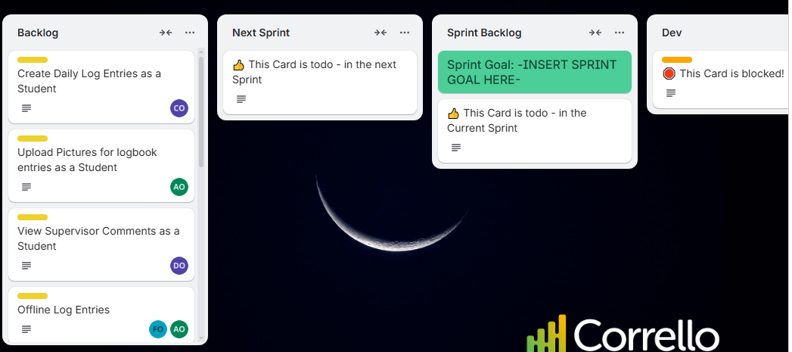
Trello Scurm

Slide 51
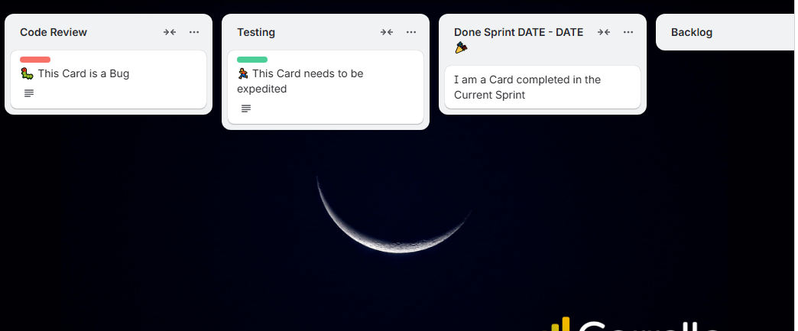
Trello Scurm

Slide 52
Assignment
https://trello.com/
Jiar
Kanban

